Slide 1
Distracted Driver
Image Classification using Convolutional Neural Nets

Slide 2
Project Brief
There is a growing problem of driver distraction resulting in accidents, there is an opportunity to identify real time driver distraction that can trigger warning, alerts or actionable task to avoid accidents. Warnings may range from alerting the driver to other mitigating steps like initiating deceleration or soft braking.
This approach suggests a method to detect and classify visual distraction. It will adopt convolution neural networks and other machine learning classification models to construct distraction detection models. Data for training and testing the models have been collected from the Kaggle site and will be used to classify distracted driver behavior.

Slide 3
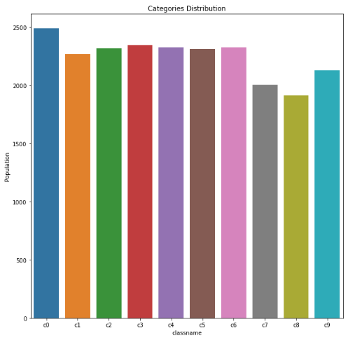
Data Description
There are in total 22424 Training Images. The image size is 640x480x3. There are in total 10 classes and approximately 2240 images in each class. There are 26 unique drivers performing 10 different actions.
c0: safe driving
c1: texting - right
c2: talking on the phone - right
c3: texting - left
c4: talking on the phone - left
c5: operating the radio
c6: drinking
c7: reaching behind
c8: hair and makeup
c9: talking to passenger

Slide 4
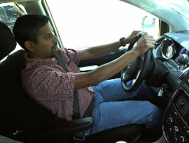
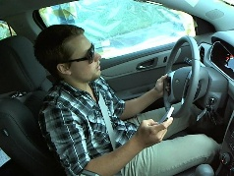
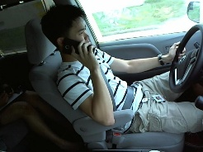
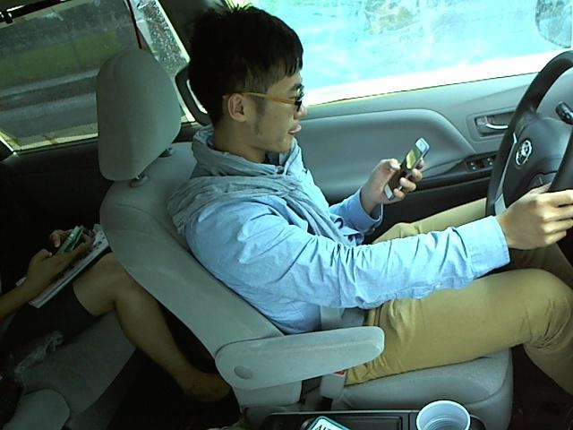
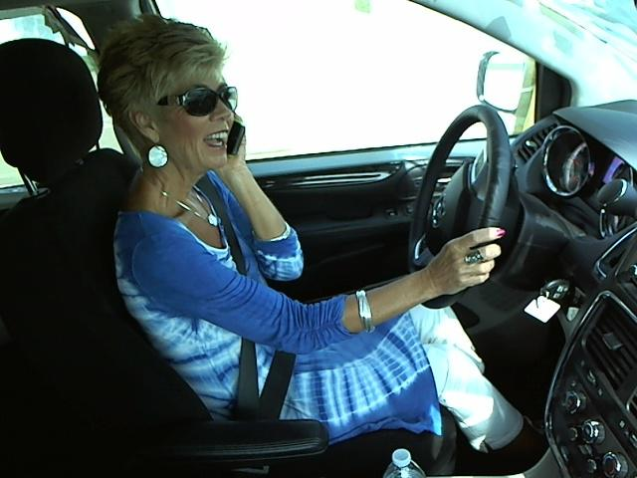
Data Used
For analysis the data selected is a subset of the original data containing 11745 images across 5 categories.
c0: Safe driving
c1: Texting - right
c2: Talking - right
c3: Texting - left
c4: Talking - left

Slide 5
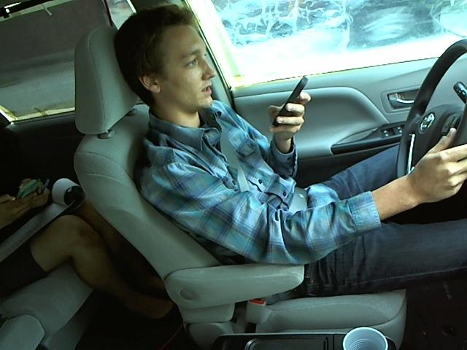
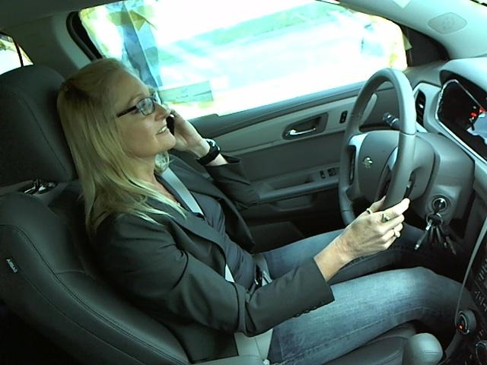

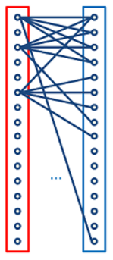
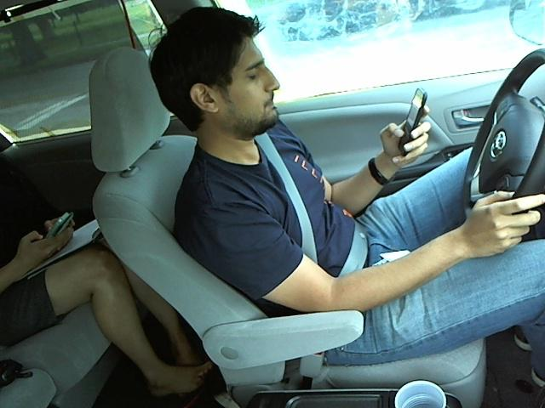
Project Architecture
Resize the image & Convert it to Gray scale
Normalize the Image
Resize Image size: 224 X 224 X 0
Divide each pixel with 255 so that we can have uniformly distributed values ranging from [0-1]
Image size: 640 X 480 X 3
c0: Safe driving
c1: Texting - right
c2: Talking on the phone - right
c3: Texting - left
c4: Talking - left
3 layer CNN + Maximum Pooling
2 fully connected layers

Slide 6
Data Pre-processing
To bring down the processing time, we pre-processed the input images to scale down the resolution and colors.
Normalized the data (divide by 255 because colour (Gray-scale) range lies between 0 to 255)
 | Original | Processed
Dimension | 640 x 480 | 224 x 224
Color | RGB | Gray scale

Slide 7
Split – Training and Testing Data
The data was divided in to Train and Test on the basis of the driver Id
Drivers which are considered in the training set are not taken in the test set to overcome the data leakage problem
Train: 9820 images (20 unique drivers)
Test: 1925 images (6 unique drivers)

Slide 8
Technical Details
Hyper-parameters | Values
Convolutional Network Layers | 3
Fully connected Dense Layers | 2
Batch-size | 200
Maximum Epochs | 20
Dropout | yes
Loss-Function | Softmax
Optimizer | AdamOptimizer
Activation Function | Relu
Maximum Pooling | Yes

Slide 9
Results
 |  | Predicted
 |  | 0 | 1 | 2 | 3 | 4
Actual | 0 | 188 | 12 | 47 | 27 | 124
 | 1 | 14 | 229 | 45 | 33 | 76
 | 2 | 39 | 42 | 158 | 25 | 124
 | 3 | 2 | 0 | 2 | 277 | 88
 | 4 | 0 | 0 | 0 | 0 | 373
Test accuracy: 0.752727272727

Slide 10
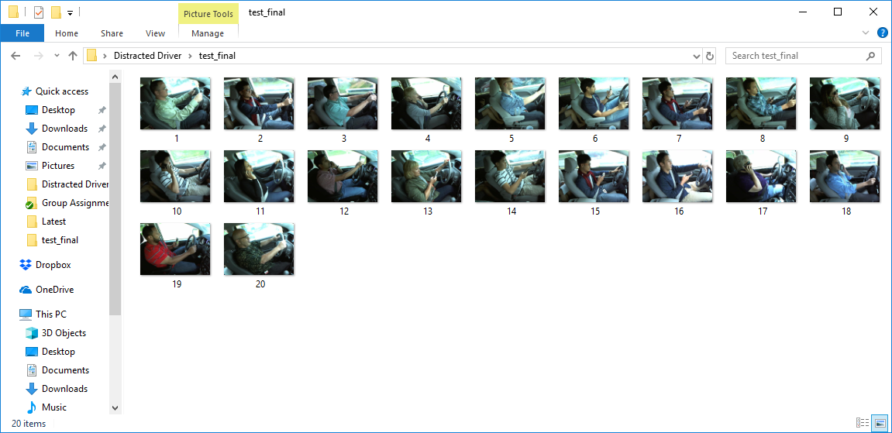
Demo

Slide 11
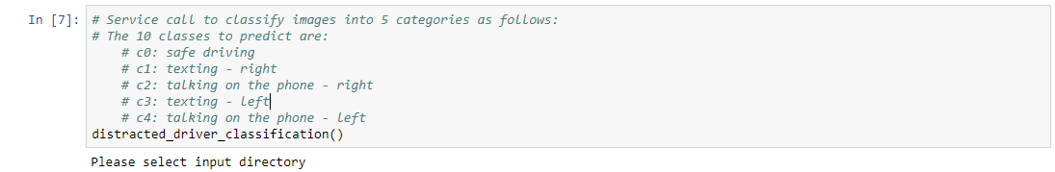
Demo

Slide 12
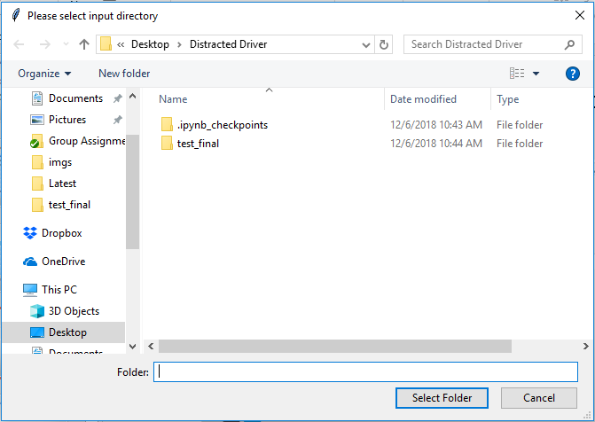
Demo

Slide 13
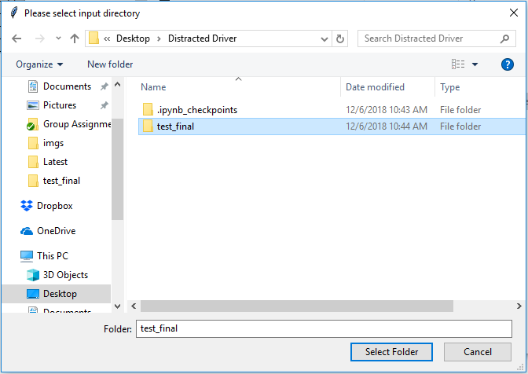
Demo

Slide 14
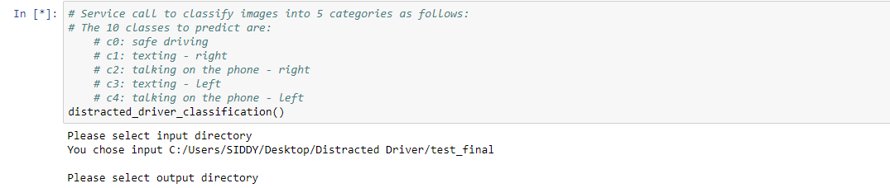
Demo

Slide 15
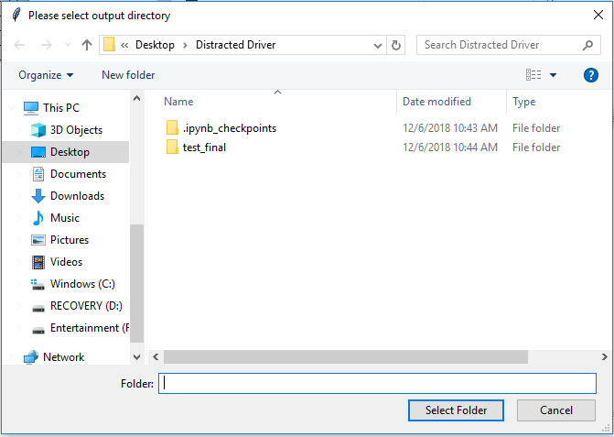
Demo

Slide 16
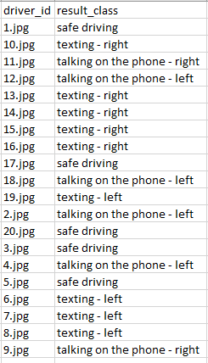
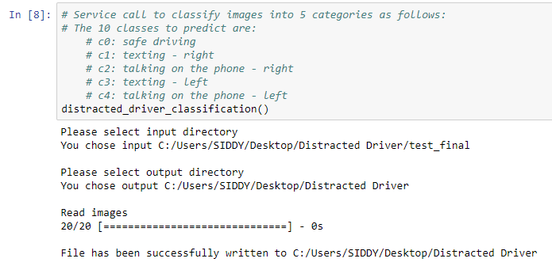
Demo

Slide 17
Problems / Challenges Faced
The data was too huge to pass on the convolutional layers
Installing Tensorflow for running on GPU
Improvising performance for 10 categories with 4 GBs GPU was difficult to achieve
Run time for the model even with 5 categories took around 45 mins

Slide 18
Thank you
Any Questions?

Slide 19
References
https://www.kaggle.com/c/state-farm-distracted-driver-detection
https://machinelearningmastery.com/transfer-learning-for-deep-learning/
http://cs231n.github.io/convolutional-networks/
http://cs229.stanford.edu/proj2016/report/SamCenLuo-ClassificationOfDriverDistraction-report.pdf
https://www.kaggle.com/jacobkie/discussion

